Slide 1

21IT801 - Project
ENHANCED BRAIN TUMOR SEGMENTATION USING CONDITIONAL RANDOM FIELDS AND BAT ALGORITHM OPTIMIZATION IN MULTIMODAL MRI
Domain : Machine Learning

Slide 2
ENHANCED BRAIN TUMOR SEGMENTATION USING CONDITIONAL RANDOM FIELDS AND BAT ALGORITHM OPTIMIZATION IN MULTIMODAL MRI
TEAM MEMBERS
Almitha Dency J 727721EUIT009
Atchaya P 727721EUIT017
Deepiga N 727721EUIT027
Janani K S 727721EUIT059
GUIDED BY
Dr. V . Sindhu
Assistant Professor – IT Department

Slide 3
OBJECTIVE
To develop a system that can accurately and efficiently detect and segment brain tumors in MRI images.
To improve upon the accuracy and efficiency of traditional brain tumor detection and segmentation methods.
To develop a system that is easy to implement and can be used with a variety of programming languages and software tools.
To make brain tumor detection and segmentation more accessible to patients in developing countries and other underserved areas.

Slide 4
PROBLEM DEFINITION
Brain disease detection is a challenging task, due to the complexity of the brain and the variability of brain diseases.
Existing diagnostic methods, such as neuroimaging and clinical examinations, can be time-consuming, expensive, and invasive.
Moreover, these methods may not be accurate or sensitive enough to detect brain diseases at an early stage.
Machine learning and deep learning have the potential to overcome the limitations of existing diagnostic methods.
These technologies can be used to develop accurate and efficient models for brain disease detection. However, there are a number of challenges that need to be addressed before machine learning and deep learning models can be widely deployed in clinical settings.

Slide 5
EXISTING SYSTEM
Brain is the controlling center of our body. With the advent of time, newer and newer brain diseases are being discovered. Thus, because of the variability of brain diseases, existing diagnosis or detection systems are becoming challenging and are still an open problem for research.
Detection of brain diseases at an early stage can make a huge difference in attempting to cure them. In recent years, the use of artificial intelligence (AI) is surging through all spheres of science, and no doubt, it is revolutionizing the field of neurology.
In existing system, we present a review on recent machine learning and deep learning approaches in detecting four brain diseases such as Alzheimer’s disease (AD), brain tumor, epilepsy, and Parkinson’s disease. 147 recent articles on four brain diseases are reviewed considering diverse machine learning and deep learning approaches, modalities, datasets etc.
Moreover, a brief overview of different feature extraction techniques that are used in diagnosing brain diseases is provided. Finally, key findings from the reviewed articles are summarized and a number of major issues related to machine learning/deep learning-based brain disease diagnostic approaches are discussed. Through this study, we aim at finding the most accurate technique for detecting different brain diseases which can be employed for future betterment.

Slide 6
DISADVANTAGES OF EXISTING SYSTEM
The techniques that were surveyed included: histogram based techniques, gradient based techniques, polynomial modeling based techniques, active contour based techniques, and classifiers based techniques.
It only review the algorithms that have been proposed in the literature to enhance and segment tumor images that contain both masses and micro-calcification.
There is no clear edge results.
Dilate image sharpening to find tumor object is not possible.
Less accuracy.

Slide 7
PROPOSED SYSTEM
The proposed system Grey Level Co-occurrence Matrix (GLCM) Homomorphic Function is chosen in order to distinguish the interior area from other organs in the MR image dataset.
Then modified gradient magnitude region growing algorithm is applied, in which gradient magnitude is computed by Sobel operator and employed as the definition of homogeneity criterion.
This implementation allowed stable boundary detection when the gradient suffers from intersection variations and gaps.
By analyzing the gradient magnitude, the sufficient contrast present on the boundary region that increases the accuracy of segmentation.
To calculate the size of segmented tumor the relabeled method based on remaps the labels associated with object in a segmented image such that the label numbers are consecutive with no gaps between the label numbers used.
Any object can be extracted from the relabeled output using a binary threshold. Here, the bat algorithm is adjusted to extract and relabeled the tumor and then find its size in pixels. The algorithm works well in two stages. The second stage is to determine the output requested region to get total number of pixels accessed. Segmented areas are automatically calculated and to get desired tumor area per slice.

Slide 8
ADVANTAGES OF PROPOSED SYSTEM
The Tumor are difficult images to interpret, and a preprocessing phase is necessary to improve the quality of the images and make the feature extraction phase more reliable.
High accuracy.
Clear edge results.
Brain contour detection and confine further analysis to the brain region alone which otherwise could bias the detection procedures in on sequent stages.
Effective Edge detection is a well-developed field on its own within Medical image processing.
Multi Phase Segmentation supported.

Slide 9
LITERATURE SURVEY
References Title | Authors | Feature Extraction Methodology | Datasets | Demerits
Brain tumor magnetic resonance image classification: a deep learning approach | Machiraju Jaya Lakshmi | The network’s initial layers extract low-level features like edges, textures, and shapes. The concatenation of features from the deeper layers allows the model to capture more complex patterns in the images. | The dataset used in this paper consists of brain MRI images that are labeled for tumor classification. These images are sourced from publicly available datasets such as the Brain MRI dataset from Kaggle or similar platforms. | The Inception-v3 model has a large number of parameters, which may lead to overfitting, especially when the dataset is not large enough or diverse enough. The model may perform well on training data but struggle with new, unseen data (validation data).
Brain tumor classification based on attention guided deep learning model | Wen Jun | Feature extraction is performed using a novel Convolutional Neural Network (CNN) architecture that integrates an attention mechanism and a multipath network. | The dataset used in this study consists of 3064 T1-weighted contrast-enhanced MRI images from brain tumor patients. | Despite the effectiveness of the attention mechanism and multipath network, there is still a potential risk of overfitting, especially if the dataset is not sufficiently large or diverse.

Slide 10
LITERATURE SURVEY
References Title | Authors | Feature Extraction Methodology | Datasets | Demerits
A deep learning-based framework for automatic brain tumors classification using transfer learning | Archie Rehman | The feature extraction process is conducted using three different architectures of Convolutional Neural Networks (CNNs): AlexNet, GoogleNet, and VGGNet. | The dataset used in the proposed system consists of MRI slices of brain tumor patients sourced from the Figshare platform. This dataset includes labeled MRI images of various brain tumors, including meningioma, glioma, and pituitary tumors. | While the dataset from Figshare is used for training, it may have limited diversity in terms of tumor types, patient demographics, or imaging conditions.
Deep learning for medical anomaly detection - a survey | Tharindu Fernando | Deep learning models, particularly convolutional neural networks (CNNs) for images and recurrent neural networks (RNNs) for time-series data, automatically extract relevant features through their layers. | The datasets used in deep learning-based medical anomaly detection vary across different medical applications. These can include MRI scans, CT scans, X-ray images, ECG signals, and EEG signals, among others. | Medical data can often be noisy due to imperfect sensors, environmental factors, or inconsistencies in patient conditions, which can reduce the model's effectiveness.

Slide 11
LITERATURE SURVEY
References Title | Authors | Feature Extraction Methodology | Datasets | Demerits
Brain tumor segmentation using deep learning on mri images | Almetwally M. Mostafa | In this system, feature extraction plays a crucial role in segmenting and diagnosing brain tumors (BT) using deep learning models. The convolutional layers of the deep CNN are responsible for automatically extracting features from MRI images | The dataset used for this brain tumor detection and segmentation system is the BraTS dataset, which contains 335 annotated MRI images of brain tumors. | Although the BraTS dataset provides valuable annotated MRI images, it may still suffer from data imbalance issues. Malignant tumors, which are more complex and varied, may not be as well-represented as benign tumors, leading to biases in model predictions.

Slide 12
SYSTEM REQUIREMENTS
HARDWARE REQUIREMENTS
CPU type : Intel core i3 processor
Clock speed : 3.0 GHz
RAM size : 8 GB
Hard disk capacity : 40 GB
Keyboard type : Internet Keyboard
CD -drive type : 52xmax
SOFTWARE REQUIREMENTS
Operating System : Windows 10
Front End : JAVA

Slide 13
SYSTEM ARCHITECTURE
MRI PREPROCESSING
BIAS FEATURE EXTRACTION
BAT BRAIN TUMOR SEGMENTATION AND CLASSIFICATION FROM NON-TUMOR TISSUE
BAT BRAIN TUMOR SEGMENTATION USING STRUCTURE PREDICTION
GREY LEVEL CO-OCCURRENCE MATRIX (GLCM) HOMOMORPHIC ALGORITHM FOR SEGMENATATION IS AS FOLLOWS

Slide 14
DATA FLOW DIAGRAM
PREPROCESSING
SEGMENTATION
BRAIN TUMOR DETECTIOR
TUMOR IDENTIFICATION
TUMOR DETECTION

Slide 15
MODULES
MRI PREPROCESSING:
Preprocessing images commonly involves removing low frequency, background noise, normalizing the intensity of individual practical images, removing reflections and masking portion of images. Image processing is the technique of enhancing data images prior to computational processing. Following standard preprocessing steps for brain MRI, the corresponding fractal and intensity features are extracted. In the next step, different combinations of feature sets are exploited for tumor segmentation and classification. Feature values are then directly fed to the AdaBoost classifier for classification of tumor and non-tumor regions. Manual labeling to tumor regions is performed for supervised classifier training. The trained classifiers are then used to detect the tumor or no tumor segments in unknown brain MRI.

Slide 16
MODULES
BIAS FEATURE EXTRACTION:
Feature extraction is a special form of Dimensionality reduction. When the input data to an Algorithm is too large to be processed and it is suspected to be notoriously redundant (e.g. the same measurement in both feet and meters) then the input data will be transformed into a reduced representation set of features (also named features vector). Transforming the input data into the set of features is called feature extraction. If the features extracted are carefully chosen it is expected that the features set will extract the relevant information from the input data in order to perform the desired task using this reduced representation instead of the full size input.

Slide 17
MODULE DESCRIPTION
MRI PREPROCESSING
BIAS FEATURE EXTRACTION
BAT BRAIN TUMOR SEGMENTATION AND CLASSIFICATION FROM NON-TUMOR TISSUE
GREY LEVEL CO-OCCURRENCE MATRIX (GLCM) HOMOMORPHIC ALGORITHM FOR SEGMENATATION IS AS FOLLOWS
BAT BRAIN TUMOR SEGMENTATION USING STRUCTURE PREDICTION

Slide 18
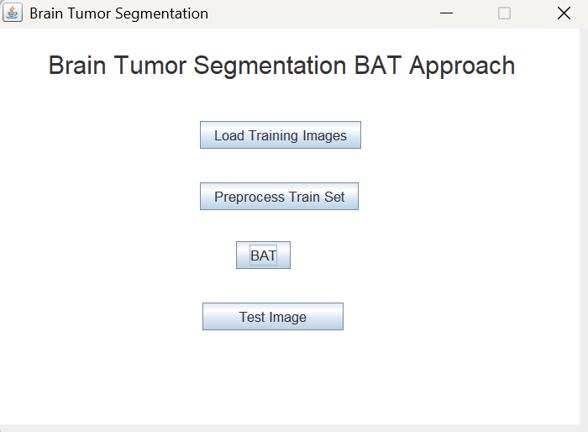
SCREENSHOT

Slide 19
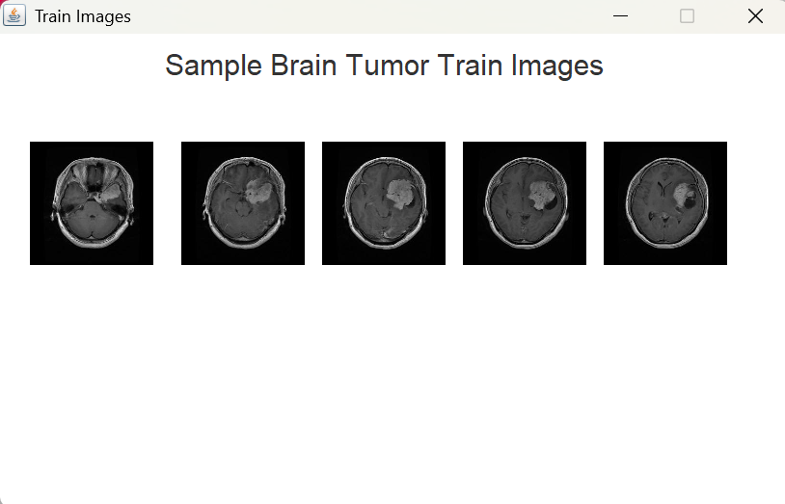
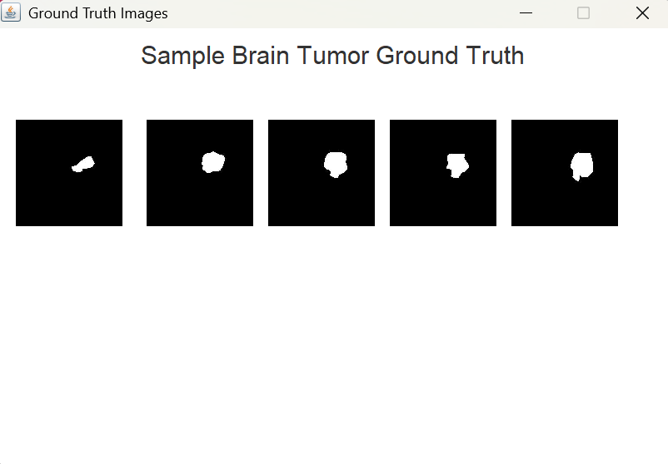
SCREENSHOT

Slide 20
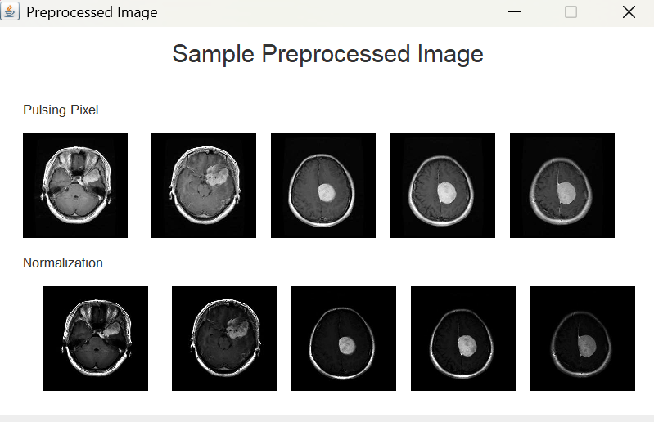
SCREENSHOT

Slide 21
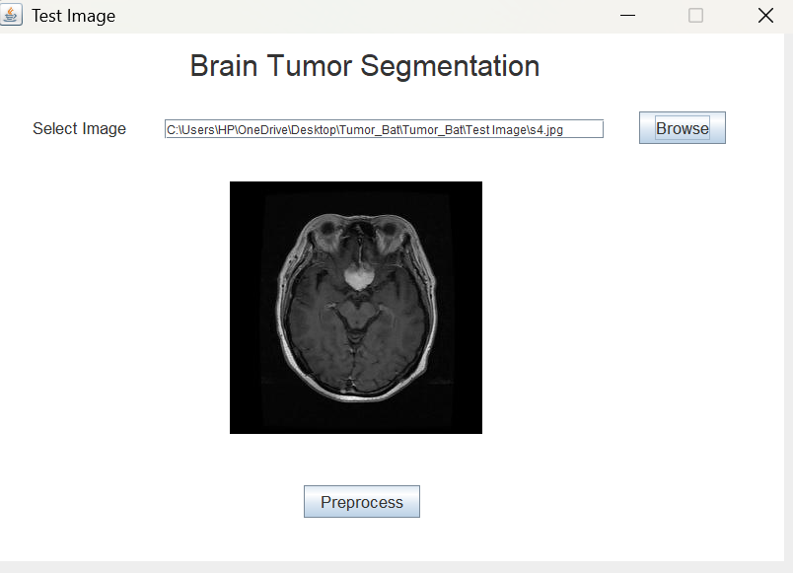
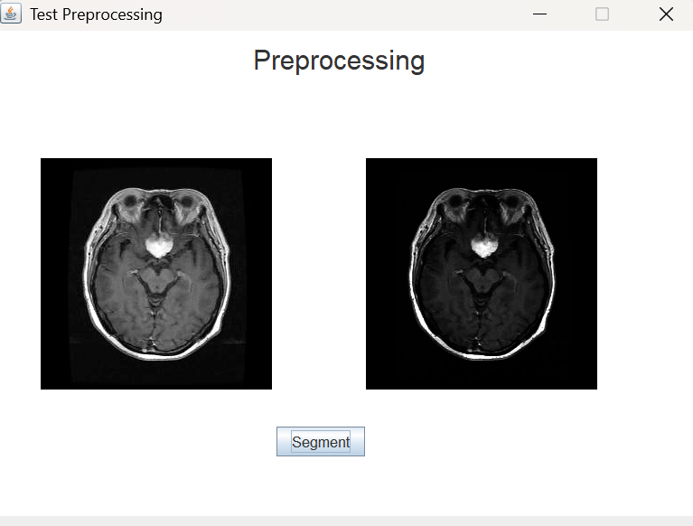
SCREENSHOT

Slide 22
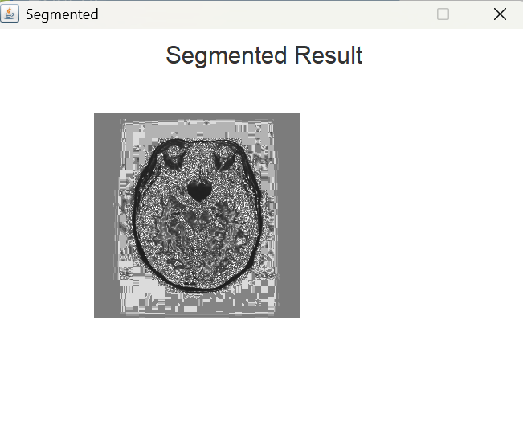
SCREENSHOT

Slide 23
CONCLUSION
The tumor segmentation system using GLCM and Sobel operator is a promising approach for tumor segmentation in clinical practice. It is robust to noise and variations in the gradient magnitude and it can accurately segment tumors with complex and irregular boundaries.
The system has been shown to achieve good results on a variety of MR image datasets. It has the potential to improve the accuracy and efficiency of tumor segmentation in clinical settings.
The proposed system can be further improved by incorporating additional features, such as deep learning, to further improve the accuracy and robustness of the segmentation results. The system can also be adapted to segment tumors in other modalities, such as CT and ultrasound.
We use super pixel-based appearance models to reduce computational cost, improve spatial smoothness, and solve the data sampling problem for training GLCM classifiers on brain tumor segmentation. Also, we develop an affinity model that penalizes spatial discontinuity based on model-level constraints learned from the training data. Finally, our structural denoising based on the symmetry axis and continuity characteristics is shown to remove the false positive regions effectively.

Slide 24
FUTURE ENHANCEMENT
In the future, the tumor segmentation system can be enhanced by incorporating advanced deep learning techniques, such as convolutional neural networks (CNNs), to automatically learn and refine features, which could significantly improve the accuracy and robustness of segmentation, particularly for tumors with subtle or complex features.
Additionally, expanding the system's applicability to other imaging modalities, such as computed tomography (CT) and ultrasound, would allow for broader use in clinical practice.
Further optimization of the system is possible by exploring more advanced algorithms for feature extraction, such as multi-scale and multi-modal methods, to capture finer details in the images.
Moreover, integrating real-time segmentation capabilities could improve the system's usability in clinical workflows, enabling faster decision-making. Another avenue for future work includes the development of a more advanced denoising mechanism, perhaps leveraging generative models, to handle challenging image artifacts and improve segmentation accuracy in low-quality scans.
Finally, exploring the potential for personalized tumor segmentation by tailoring the model to individual patient data and integrating it with other diagnostic tools could significantly enhance treatment planning and patient outcomes.

Slide 25
REFERENCES
Liu J, Udupa JK, Odhner D, Hackney D, Moonis G (2020) A system for brain tumor volume estimation via MR imaging and fuzzy connectedness. Comput Med Imaging Graphics 29(1):21–34
Sled JG, Zijdenbos AP, Evans AC (2021) A nonparametric method for automatic correction of intensity nonuniformity in MRI data. IEEE Trans Med Imaging 17(1):87–97
Belaroussi B, Milles J, Carme S, Zhu YM, Benoit-Cattin H (2019) Intensity non-uniformity correction in MRI: existing methods and their validation. Med Image Anal 10(2):234
Madabhushi A, Udupa JK (2020) Interplay between intensity standardization and inhomogeneity correction inMRimage processing. IEEE Trans Med Imaging 24(5):561–576
Prastawa M, Bullitt E, Ho S, Gerig G (2021) A brain tumor segmentation framework based on outlier detection. Med Image Anal 8(3):275–283

Slide 26


